Slide 1
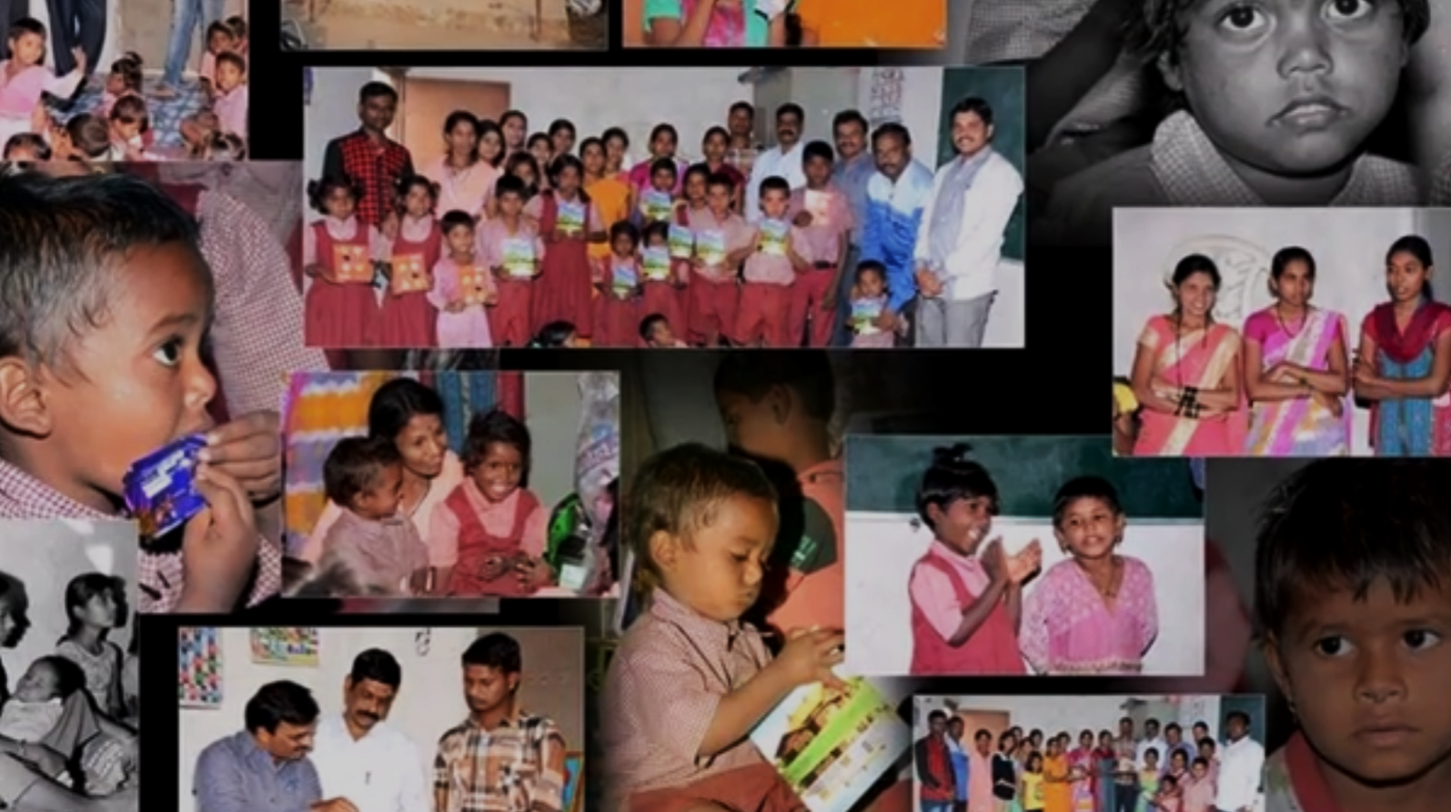

VIDYODAY MUKTANGAN PARIVAR FOUNDATION
Towards reimagining education in Zilla parishad schools
VMPF is a systems change & research organization that helps innovate the scientific temper, life skills and intellectual development of students through activity based learning modules.
Notes:
From website , relook at the phrase

Slide 2


VISION & MISSION
Vision
Mission
We envision a society where the youth are equipped with the necessary skills to address societal needs and problems through innovation and Entrepreneurship.
* Experimenting and developing innovative models of teaching and learning.
* To provide children with opportunities of application of their learning to address their real life needs and problems.

Slide 3
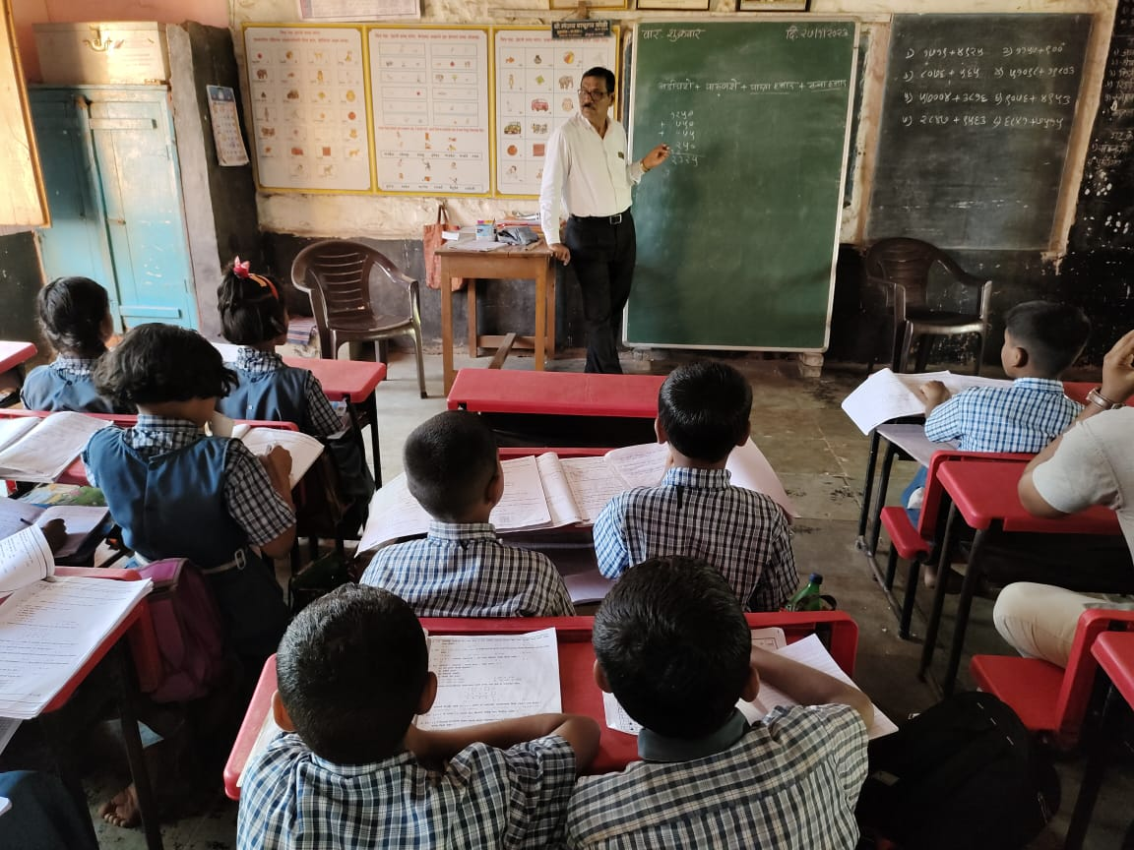
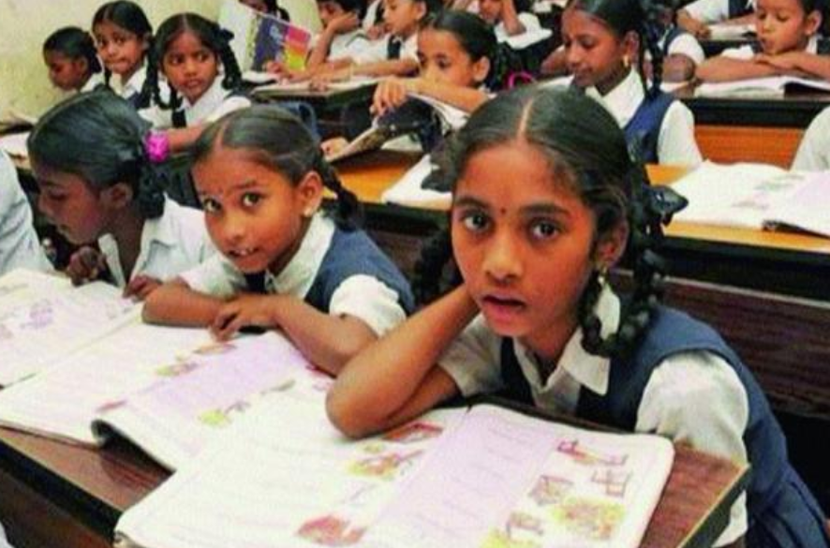
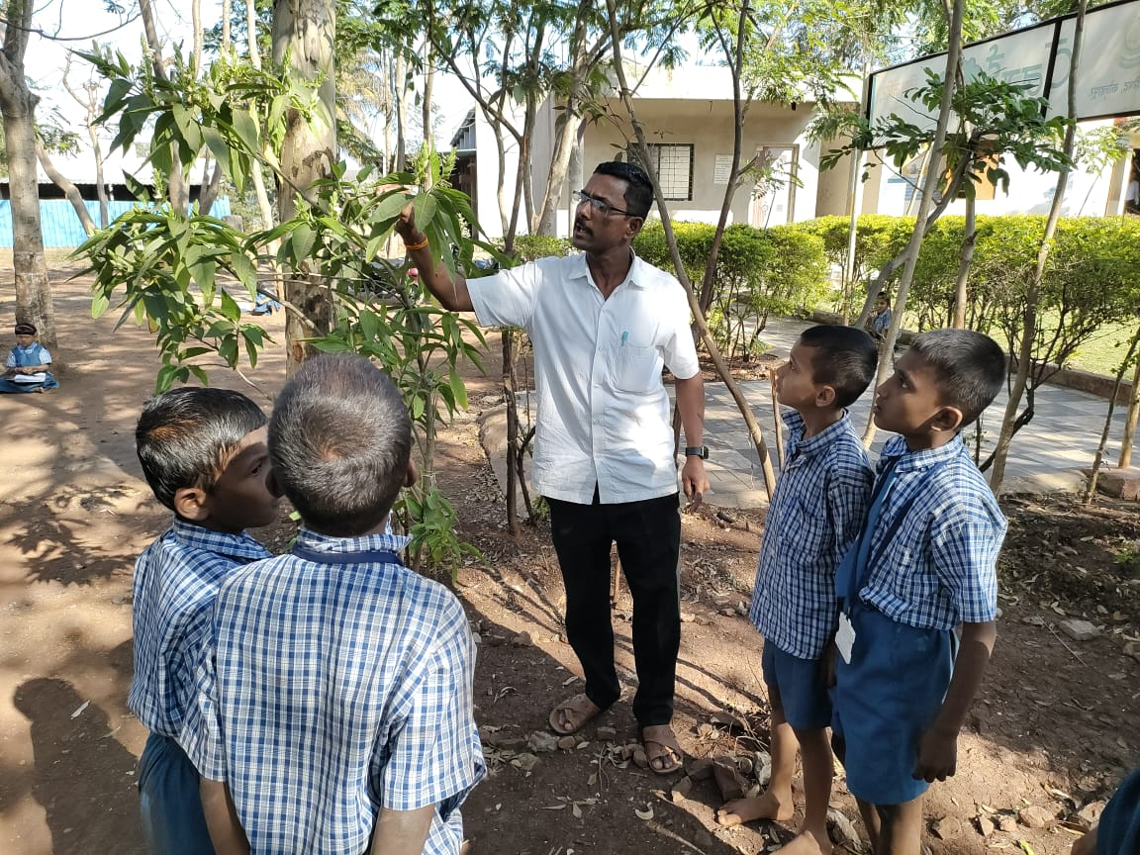
THE PROBLEM
Problem Statement
The lack of application-based and experiential learning practices in rural government schools has led to lesser interest and enhanced fear of science in children resulting in the decline of their pursuing of further science education.
26.6 % of all children in Std III are unable to read a Std II level text.
19.9 % of Std V students are not able to solve a simple subtraction and division
- (ASER 2024 DATA)
Chalk and Talk Method
Fear of Science
Lack of Application and experiential based learning

Slide 4
OUR PROJECTS
Chhote Kalam Science Project
Project Vidyankur (FLN)
Science Shikshan Samvad
Develops scientific temperament of students of Class 6th, 7th by facilitating experiential and activity based learning and through problem solving.
Builds a strong foundation in Language and Maths for students of Class 2nd to 5th who are lagging behind in the curriculum.
Capacity Building workshops for science teachers for training on experiential, activity based learning methodologies.
Bringing innovative learning practices to classroom to foster science and foundational education
Strengthening primary education by making students’ Foundation Literacy and Numerical Skills strong
Sustainable model through Fellows and Teachers’ capacity building

Slide 5
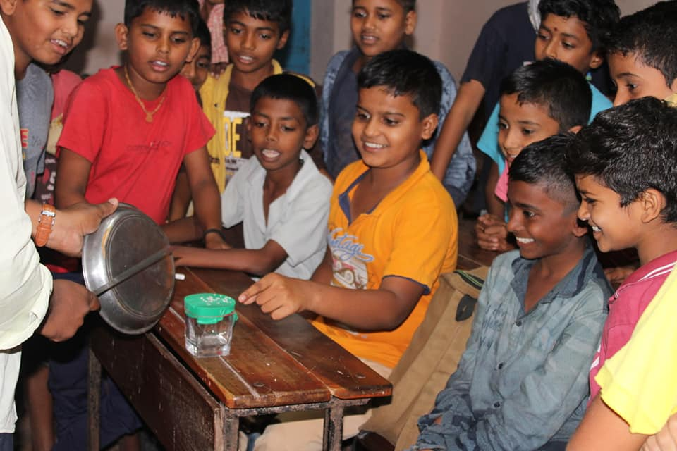
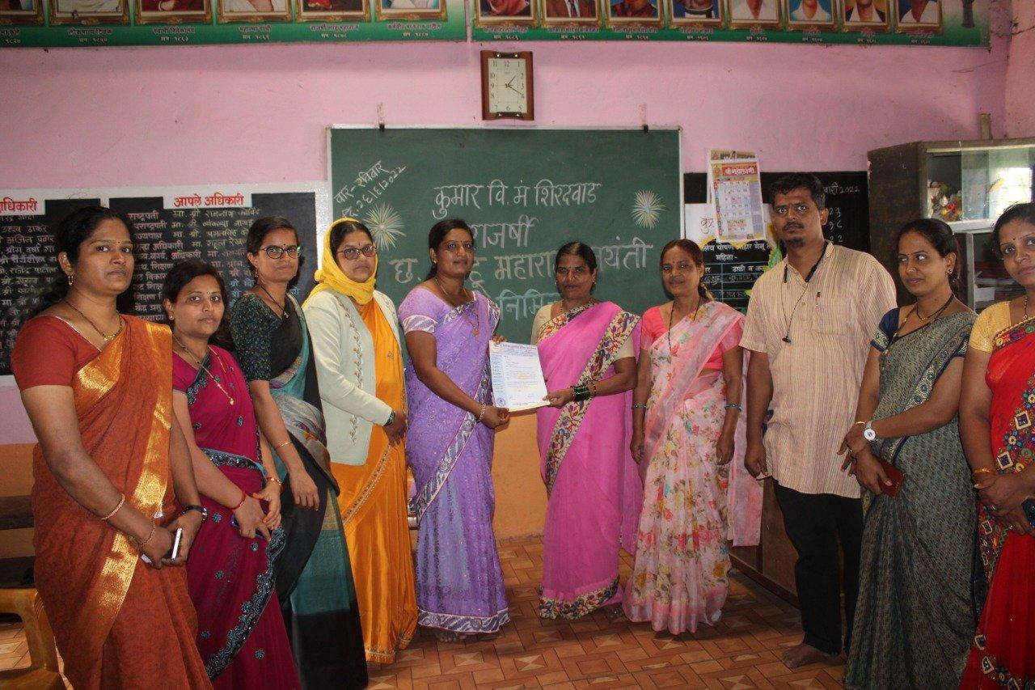
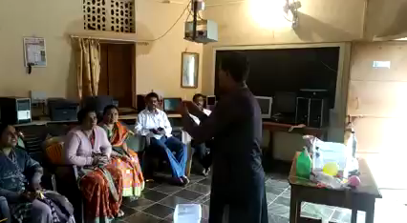
SOLUTION
Chhote Kalam
Science Project
Supporting children of Class 6th and 7th in Zilla Parishad schools by strengthening the experiential science educational ecosystem through activity based learning and problem solving experiments.
Foundation
Engagement
Development
Weekly Experiments aligned to curriculum
Partnering with Science teachers for 3 years
Shiksha Samvad/ Teachers Capacity Building and Empowerment

Slide 6
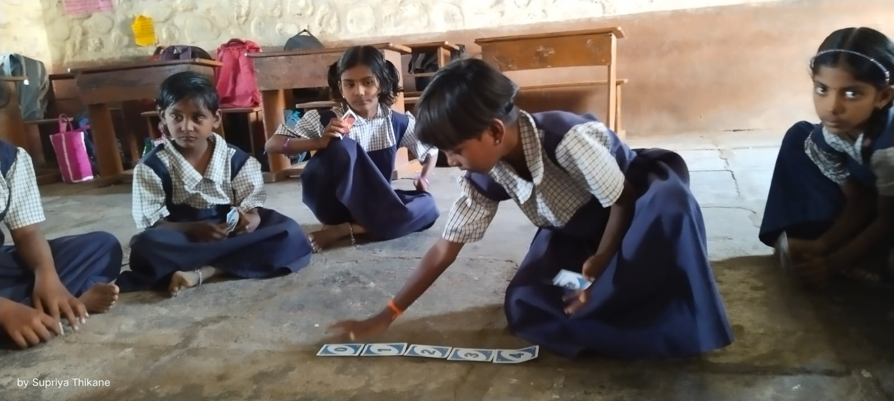
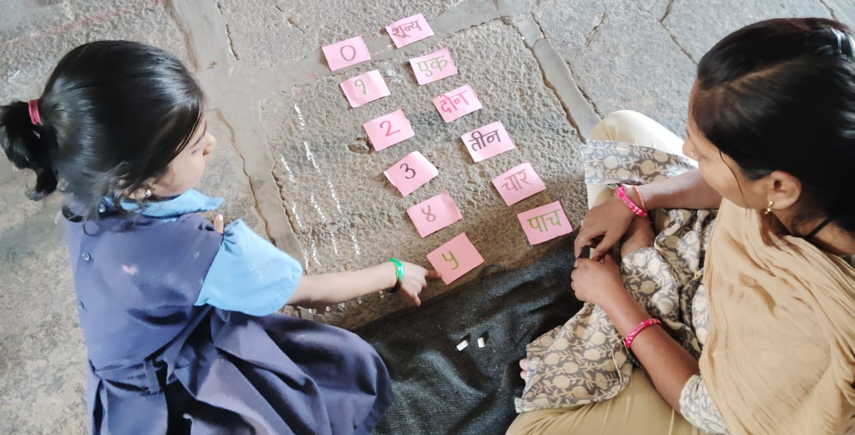
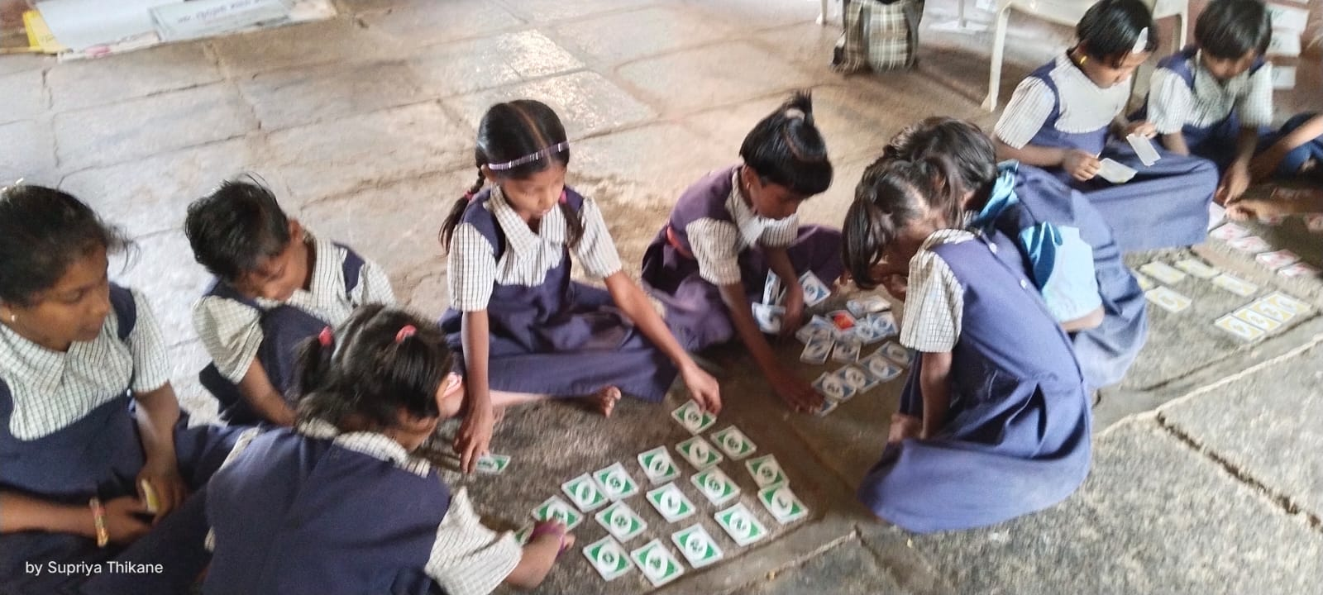
SOLUTION
Project Vidyankur: Numeracy & Literacy
Supporting children of Class 2nd to 5th in Zilla Parishad schools by strengthening the Foundational Education by building competencies in Language and Mathematics to achieve better learning outcomes.
Foundation
Engagement
Development
Activity based sessions are conducted 3 times a week by Fellows/Shikshan Mitra
Teachers give individual attention, show demos and students learn in a focused environment
Intensive training is provided to Fellows for a period of 1-2 months followed by weekly sessions

Slide 7
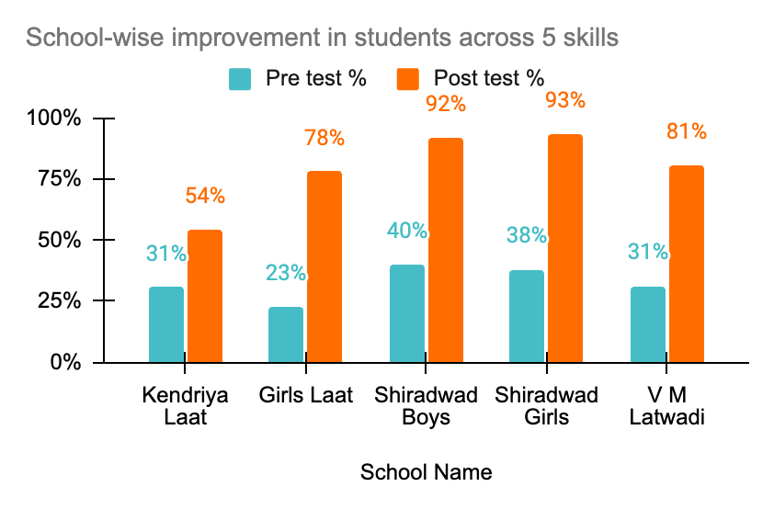
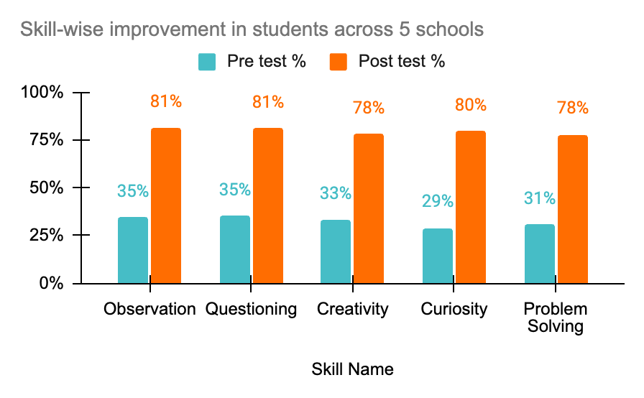
IMPACT ASSESSMENT: Chhote Kalam Project
Skill-wise improvement in the pre and post assessment of students across 5 schools (total no of students is 99)
School-wise improvement in the pre and post assessment of students across 5 skill sets

Slide 8
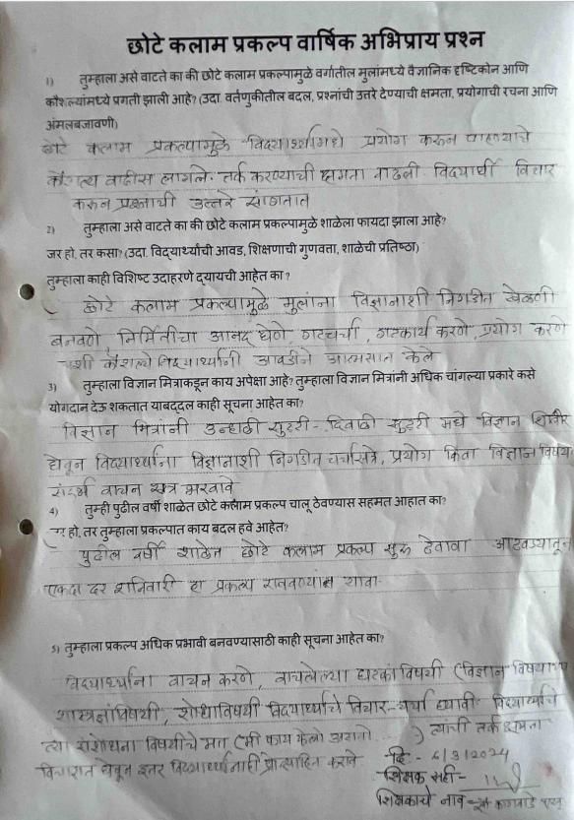
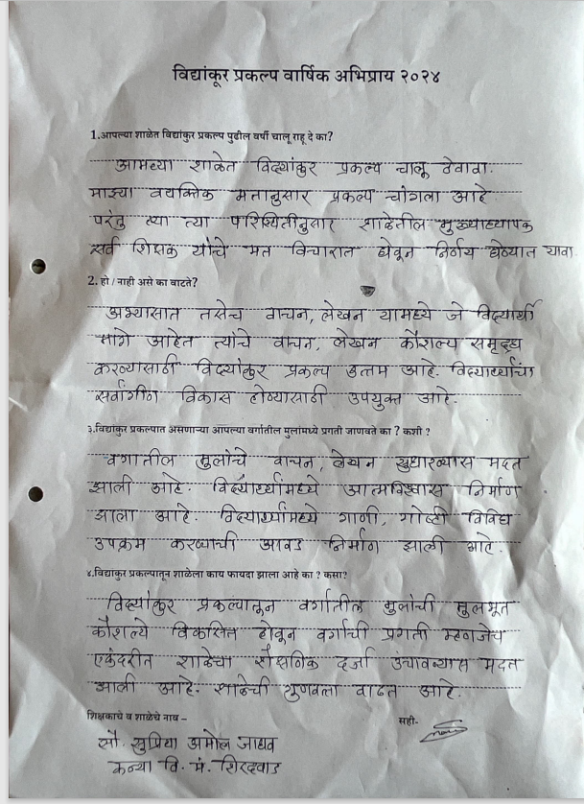
Government Teacher’s Feedback: Chhote Kalam Project
Teachers from Shiradwad Kanya schools explaining Positive Impact of Chhote Kalam project on Students in the year 2024.

Slide 9
OUTREACH 2021-2024
Number of Beneficiaries Impacted
2021 -2022
2022-2023
2023-2024
Students
80 children
264 children
420 children
Teachers/HMs
14 Teachers, 2 Headmasters
42 Teachers, 6 Headmasters
42 Teachers, 6 Headmasters
Schools
In-depth program: 2 schools
Awareness sessions: x schools
In-depth program: 6 schools
Awareness sessions: 30 schools
In-depth program: 6 schools
Awareness sessions: 30 schools
Fellows
2 Fellows
5 Fellows
8 Fellows

Slide 10
OUTREACH 2021-2024
Number of Beneficiaries Impacted
Year 1
16 teachers
6 supported in depth
8
48
30
Year 2
32 teachers
Trying to reach to 24 Schools
Fellows
Teachers
Schools
2021 -2022
2022-2023
2023-2024
80 students
264 students
420 students

Slide 11
FUTURE PLAN OF VIDYODAY
Unit Name | 2022-23 (Actual) | 2023-24 (Actual) | 2024-25 (Projected) | 2025-26 (Projected)
No. of children | 264 | 880 | 1760 | 2640
No of school | 6 | 20 | 40 | 60
No of Science Teacher | 6 | 20 | 40 | 60

Slide 12
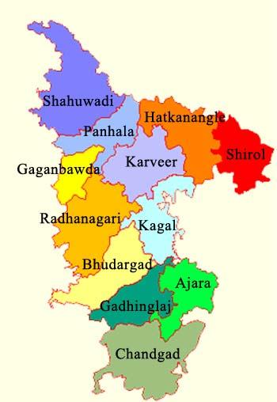
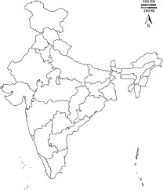
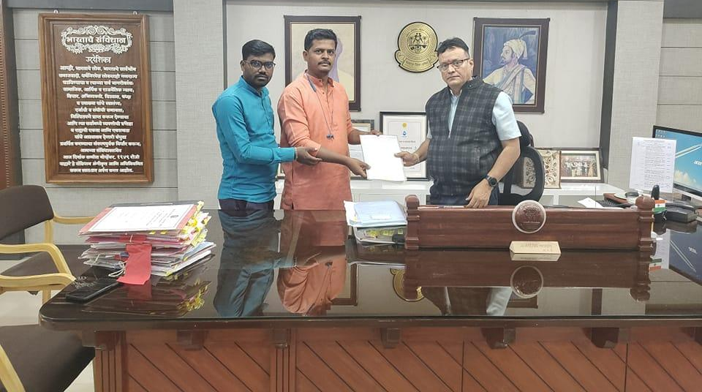
FUTURE ROADMAP
Expand to 12 blocks from 1 block in Kolhapur district in Maharashtra
Reach out to every school in the 12 blocks for Next 3 years. Presence in 60 schools by 2025-26
Reaching out to 5000+ children
Collaboration with Government to make Vidyoday program as part of the Govt. Teachers Training Program
MOU with Jilha Parishad Kolhapur

Slide 13






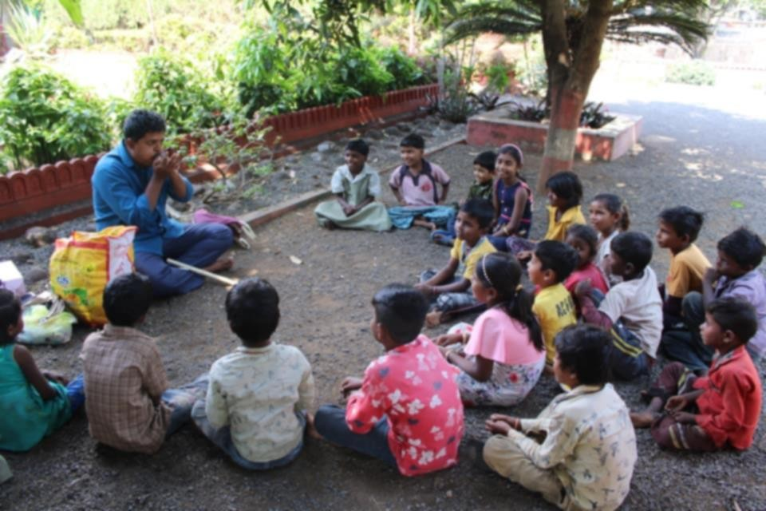
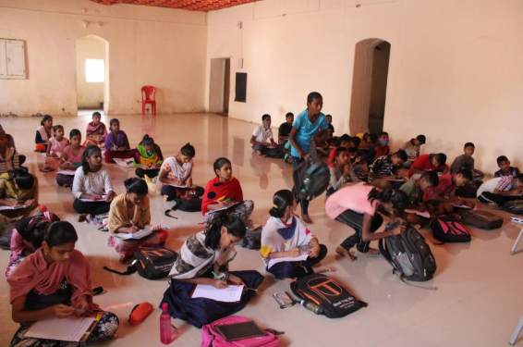
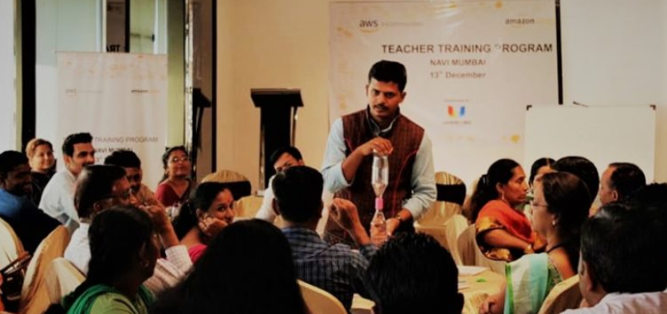
OUR PARTNERS
GALLERY

Slide 14
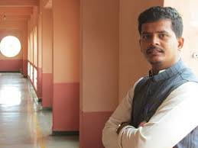
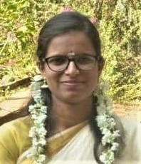
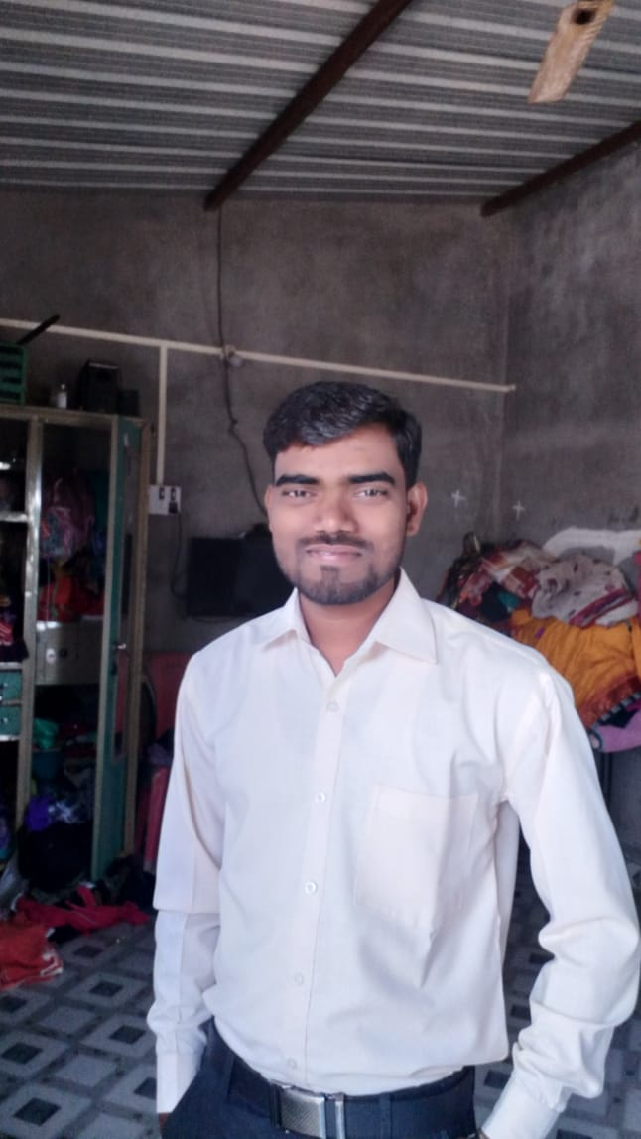
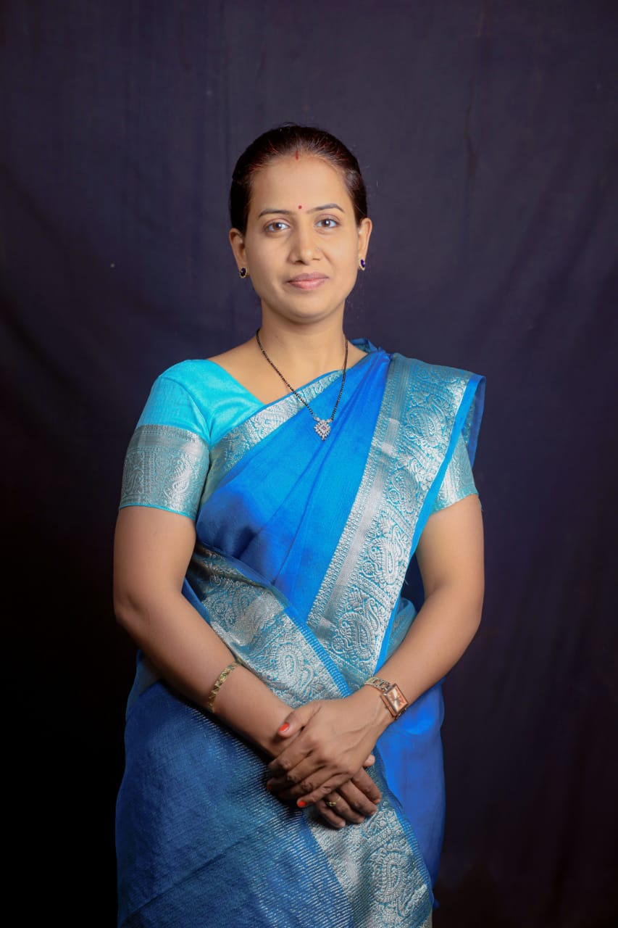
THE CORE TEAM
VINAYAK MALI
SARSHA KUMBHAR
RAJENDRA CHAUGULE
VARSHA PATIL
Co-Founder & CEO
Masters in Social work Elementary Education, TISS
Wipro Fellow
Experience 10 years
Bachelors in Statistics and Social Work (TMV, Pune)
Program Manager and Human resource management.
Experience 7 years
Bachelor's in science from Shivaji University
Coordinator of the Project and Implementation.
Experience 7 years
Diploma in engineering , M.A. Education, TISS Mumbai .
Curriculum Design
Experience 7 years

Slide 15

THANK YOU !
Address : Vidyoday Muktangan Parivar Foundation, Near Ganesh Temple, opposite Rajarshi Shahu Ground, Abdullat village, Tal. Shirol, Dist. Kolhapur, Maharashtra. -416115.
Office Location : https://goo.gl/maps/F8aVdjZDoRgu26Kw7
Contact us : Vinayak Mali (+91 9420608084)
Mail us : contactvidyoday@gmail.com
vinayakmali90@gmail.com

